Slide 1
‘Wilderness’
A professionally produced, student crewed feature film that evidences the potential of universities to engage in commercial independent film production for pedagogical return
Dr Neil Fox
Pedagogy Futures

Slide 2
Page 2
Page 3
Page 4
Pages 5-6
Pages 7-9
1

Slide 3
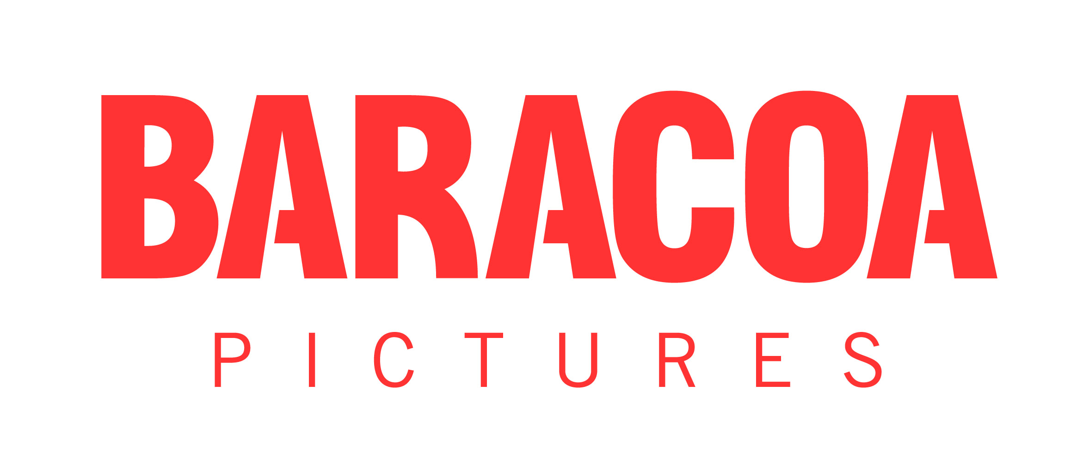
From project being greenlit, to premiere, took a miraculous 18months
Key dates
Project Greenlit – September 2015
Production – April 2016
World Premiere – March 2017
Research and Follow Up Projects – May 2017 through June 2018.
Role
Researcher, Film Screenwriter & Producer, Pedagogy Coordinator
Funders
School of Film & Television
Partners
Baracoa Pictures
Collaborators/ key people
Dr Kingsley Marshall, Prof Chris Morris (executive producers)
2

Slide 4
‘Wilderness’ is a 2017 feature film funded by the School of Film & Television at Falmouth University, produced by professionals utilising a crew comprised predominantly (75%) of undergraduate film students with no prior professional on set experience. The film production of ‘Wilderness’ was both a research question and a research method. The aim of ‘Wilderness’ was to prove that universities could incubate feature film productions that were originated by staff and crewed by students that would be indistinguishable in form and content from films made under similar economic and creative circumstances elsewhere in the independent and micro-budget filmmaking sector.
The success of ‘Wilderness’ on the film festival circuit, amongst critics and by being acquired for International distribution by Sparky Pictures is testament to this thesis. The fact that this film was made by a university film department in collaboration with film students was not the narrative that led to the film being so well received and it became clear that the film would not have been any different if it had been entirely, or largely produced by professionals.
The production of ‘Wilderness’ was designed to test the hypothesis above and at each stage the project exceeded expectations. The achievements were possible by approaching the production from an independent filmmaking tradition, using the work of John Cassavetes as detailed in the book Cassavetes on Cassavetes (ed. Ray Carney, Faber, ) as a guide.
This approach differs from both student expectations, albeit unrealistic ones, about the kind of experiences available in a university context as well as from the nominal approach to production education film courses in universities strive for, namely the replication of industry norms and cultures in the classroom setting.
In reality, university film education can much closer replicate independent film production than what might be termed ‘elite’ or even ‘mainstream’ industry production and a further reality is that independent filmmaking is where most graduate development opportunities reside for students emerging from film courses. By approaching ‘Wilderness’ as an independent film and educating students as to that particular context it became possible to complete a period feature film production with so many non-experienced participants involved in the fourteen days set aside.
Following the production, we did not expect the film to be so well-received on its own terms as a late 1960s set romantic drama in a variety of contexts - festivals, critics, distributors. In addition, ‘Wilderness’ led to increased attainment and career opportunities for students involved as well as follow-up research projects including the short film Backwoods (2018) and the formation of the Sound/Image Cinema Lab, the production and research centre based at Falmouth. The most wide-reaching legacy of 'Wilderness' is that it informed and made possible all film co-production projects the School of Film & Television has embarked on since 2016, from Jamie Adams' Songbird featuring Hollywood star Cobie Smulders in 2017 to the BFI/BBC/Creative England backed Make Up (2019) and most notably Mark Jenkin's BAFTA Award-winning Bait (2019).
3

Slide 5
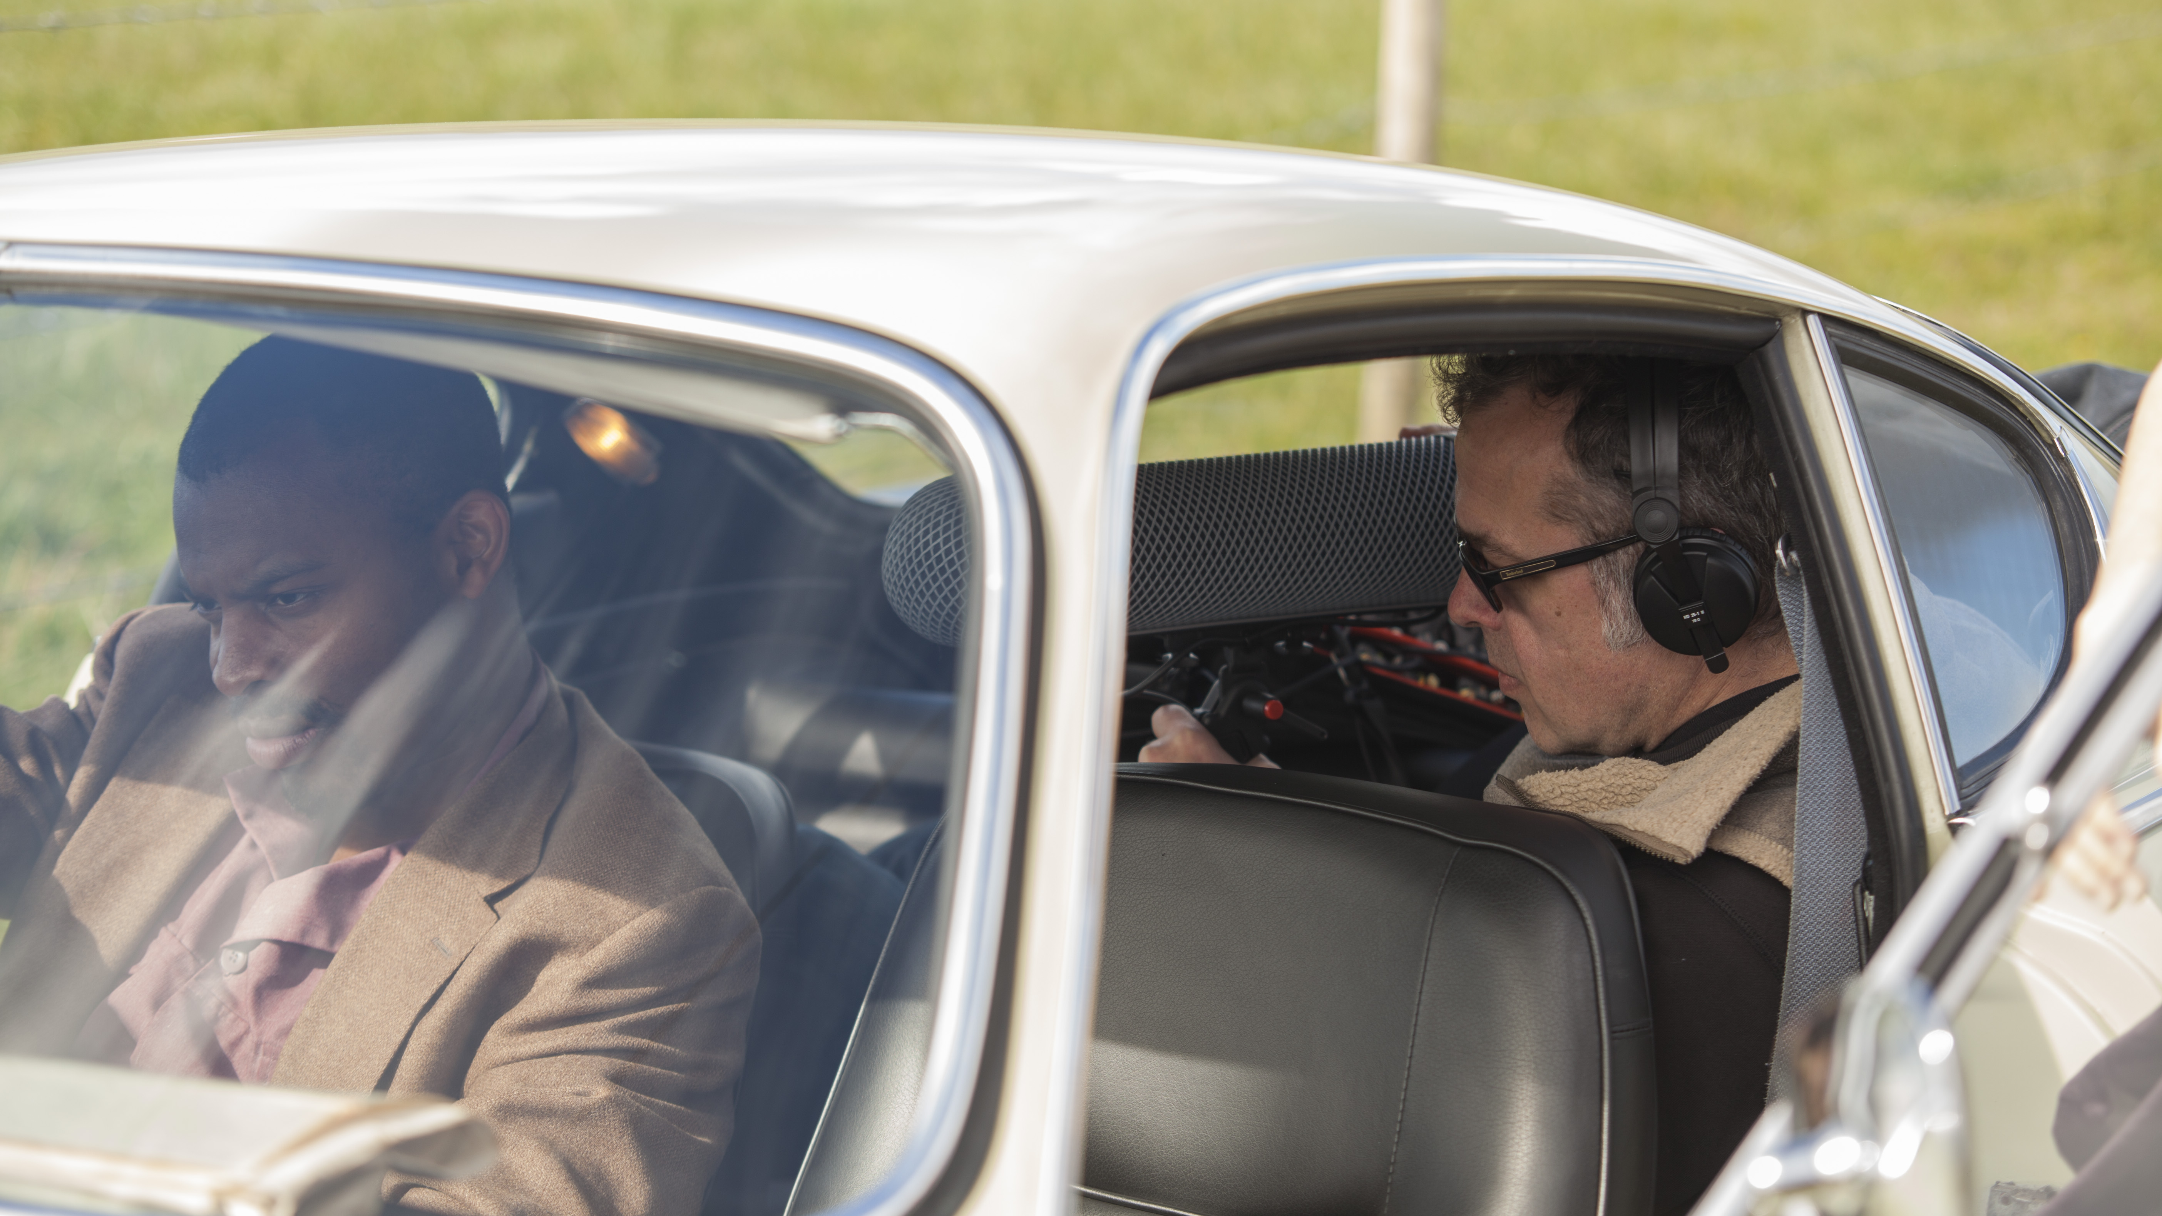
Film
https://vimeo.com/197642149
Password: johnandalice
4

Slide 6
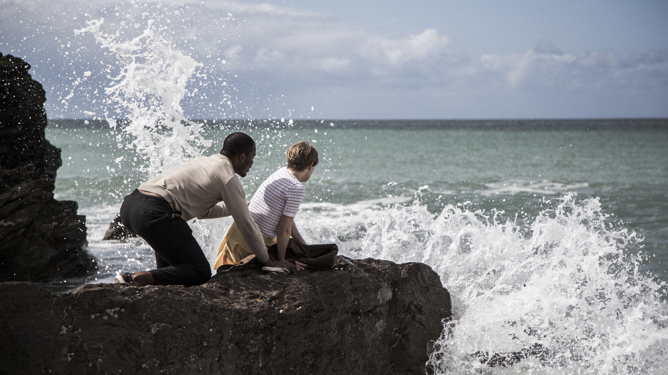
Behind The Scenes Films
14min Version - https://vimeo.com/201274100
5min Version - https://vimeo.com/200031593
5

Slide 7
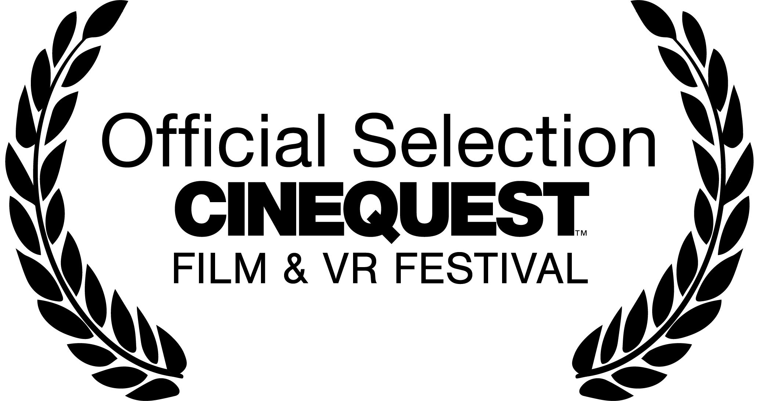
Festivals and Awards
World Premiere – Cinequest Film & VR Festival, San Jose, March 2017.
20 International Festivals including Cambridge, Indie Memphis, Dingle, Oaxaca.
13 Awards including Best Screenwriter (Chain NYC FF, Vasteras FF), Best Actress (Oaxaca, British Independent FF)
Industry Showcase Presentation – Aesthetica Short Film Festival, York, November 2017
6

Slide 8
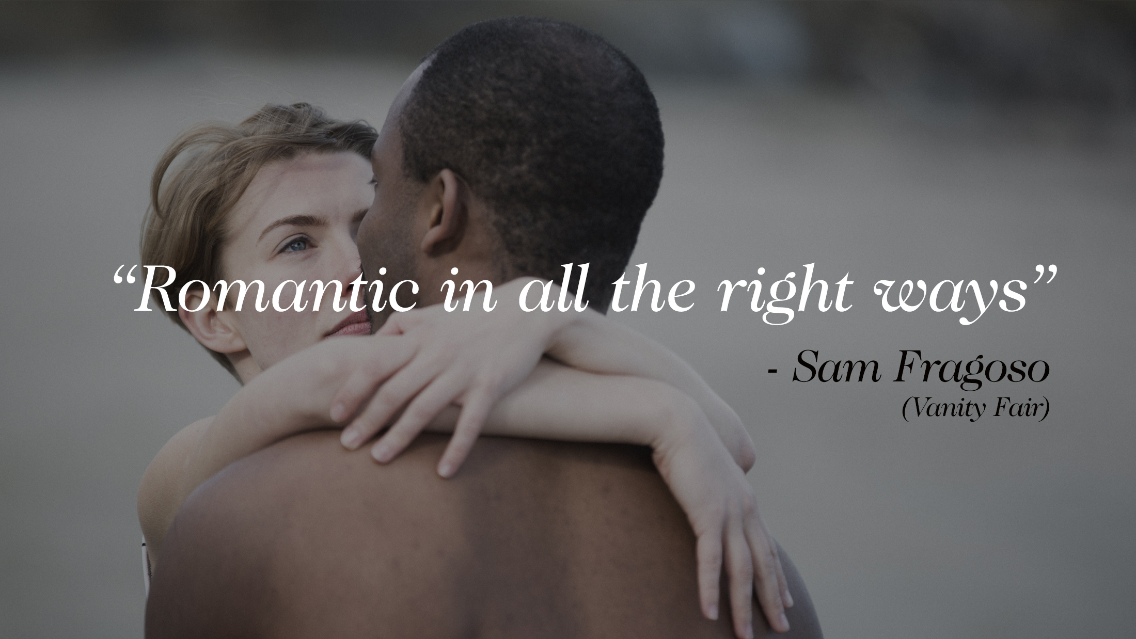
Distribution
Film acquired by Sparky Pictures for global digital distribution. Release slated for April 4th, 2021 internationally (to rent or purchase) on Apple, Amazon, Sky and Google platforms.
https://www.sparkypictures.com/about
Press Reviews
https://www.baracoapictures.com/reviews
Trailer
https://vimeo.com/185624908

Slide 9
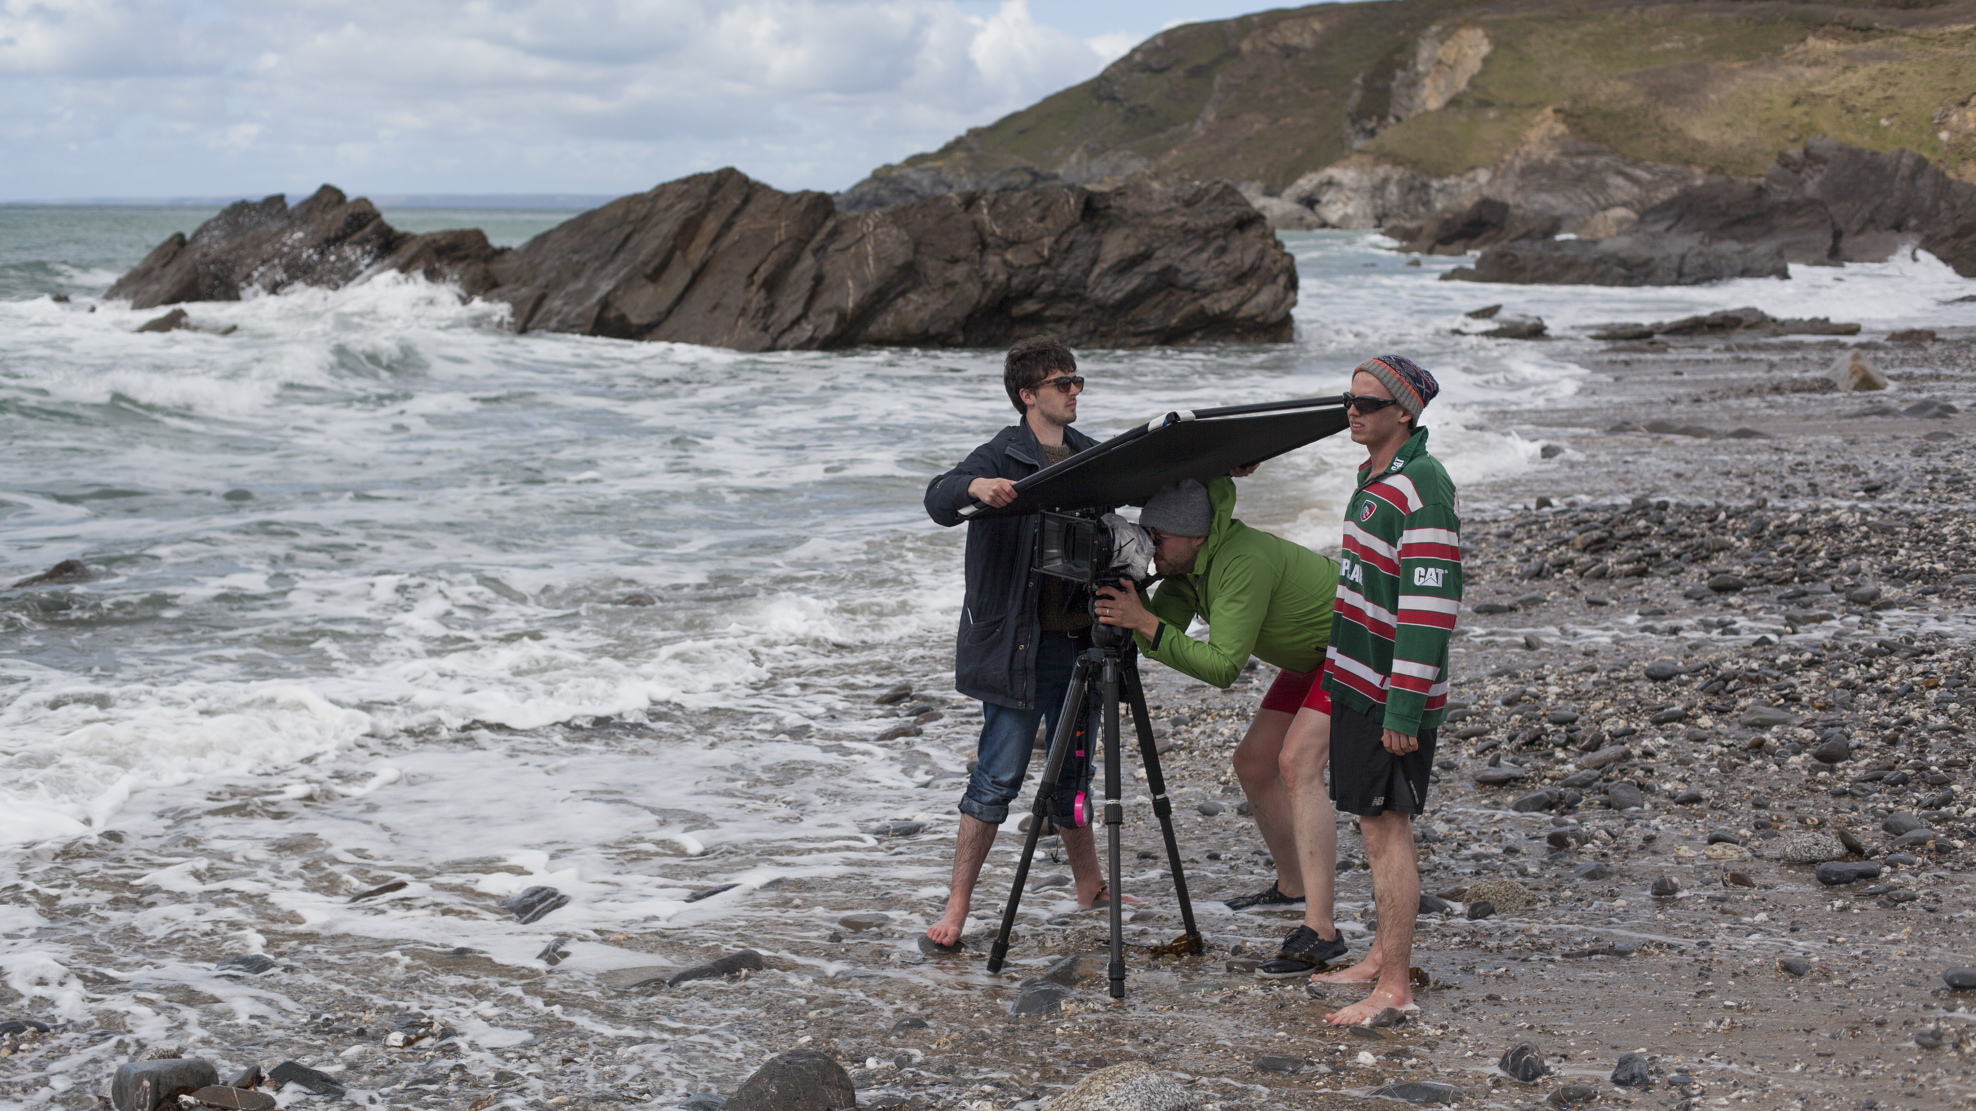
Blogs written by students during production:
https://wildernessfilmproject.tumblr.com/
Example of student post-project interviews:
https://vimeo.com/497649935

Slide 10
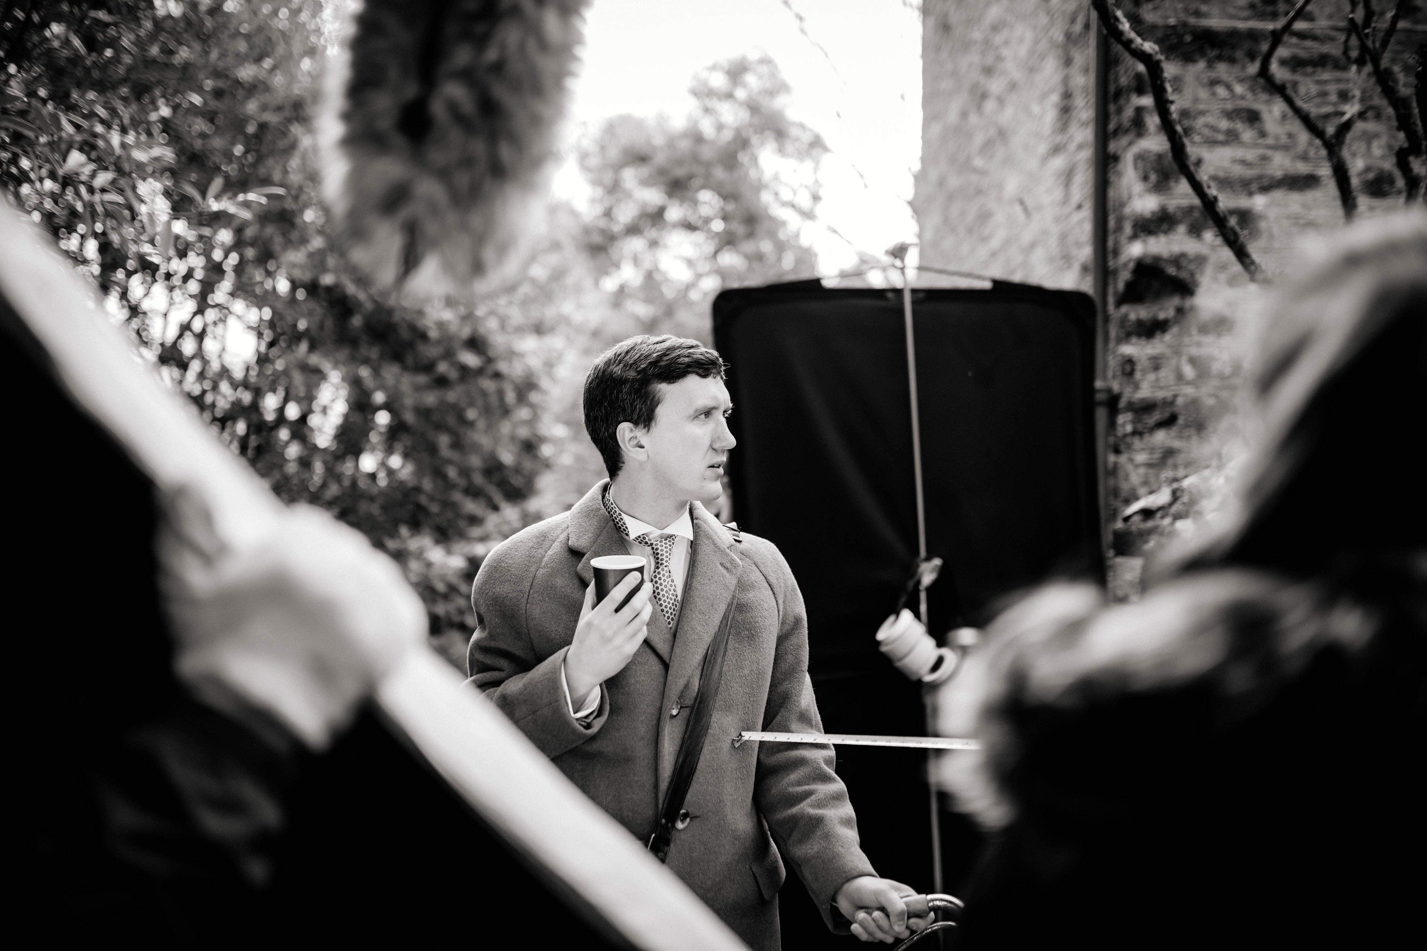

Backwoods Short Film
https://vimeo.com/306564210
Password: L0vecraf7
UK Premiere: London Short Film Festival, 2020
Winner: HP Lovecraft Award, Rhode Island Film Festival, 2019

